Slide 1
Python Tkinter Message Boxes
Session 18

Slide 2
Objectives
Yes/No Message Box in Python using tkinter
OpenDialog/SaveDialog in Tkinter
AskQuestionDialog

Slide 3
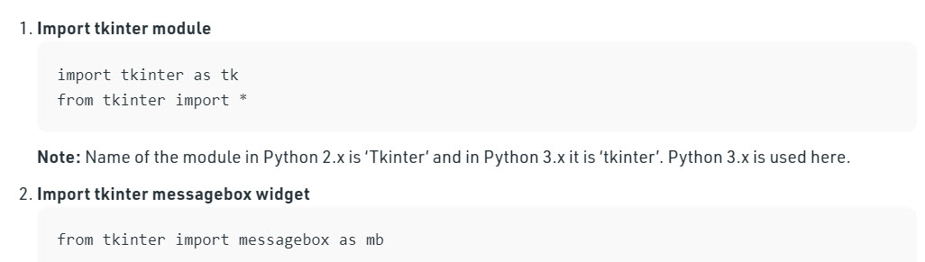
Yes/No Message Box in Tkinter

Slide 4
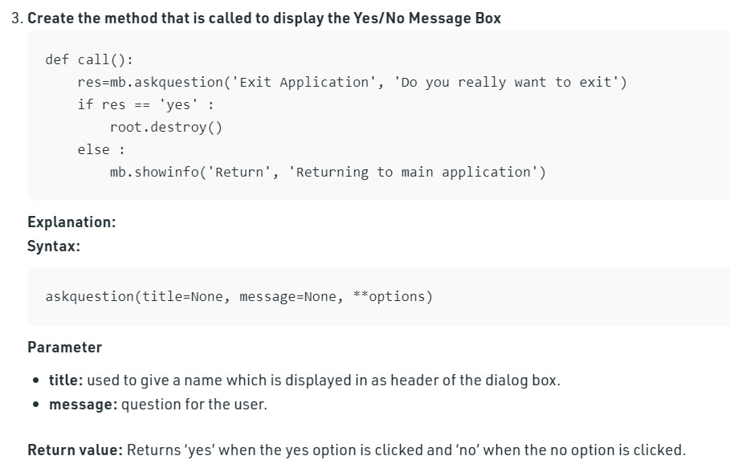
Yes/No Message Box in Tkinter

Slide 5
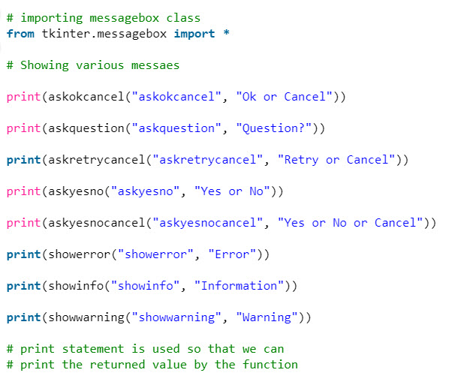
Different messages in Tkinter

Slide 6
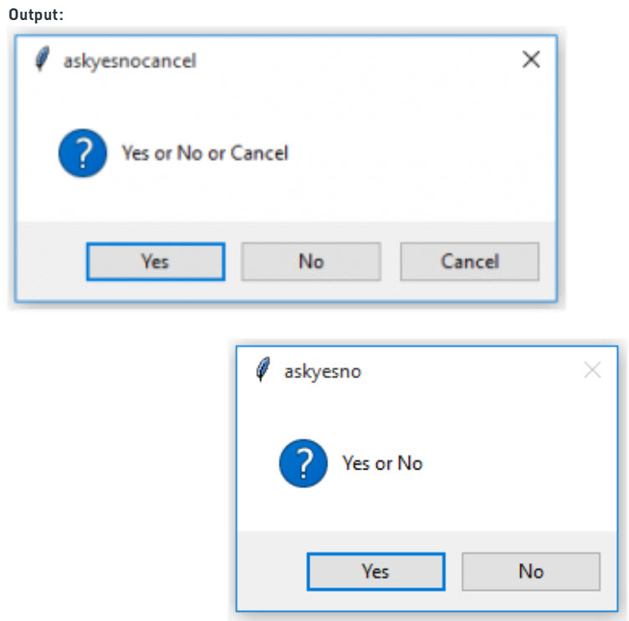
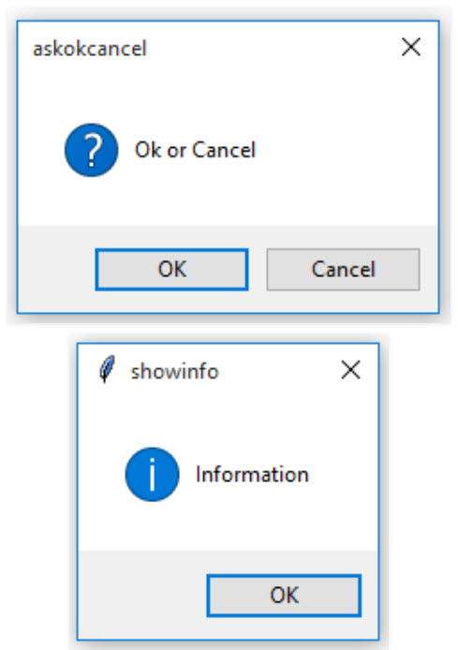
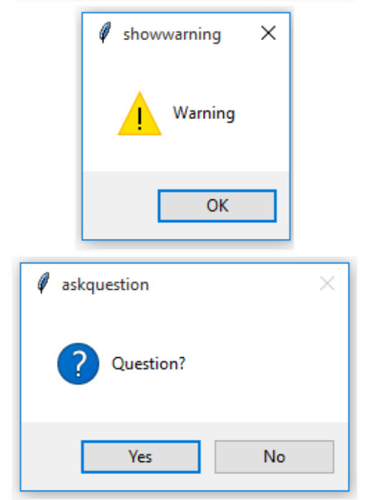
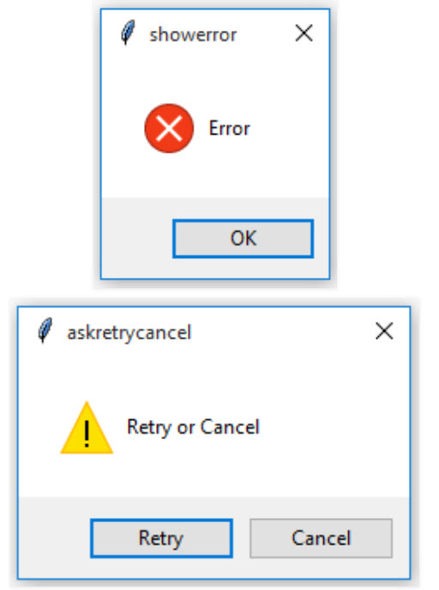
Different messages in Tkinter

Slide 7
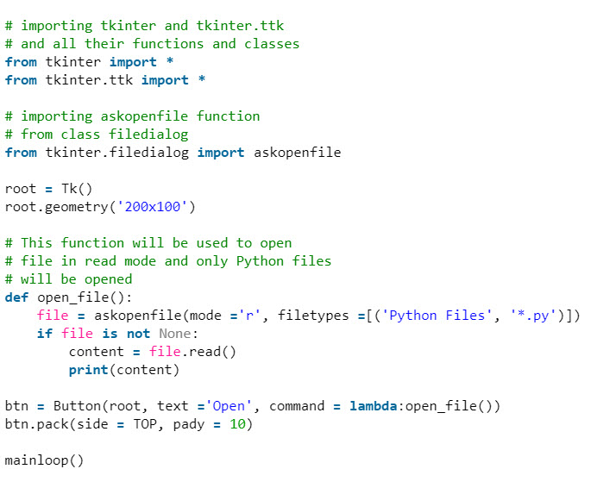
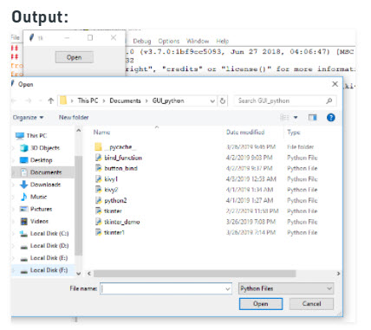
askopenfile() function in Tkinter

Slide 8
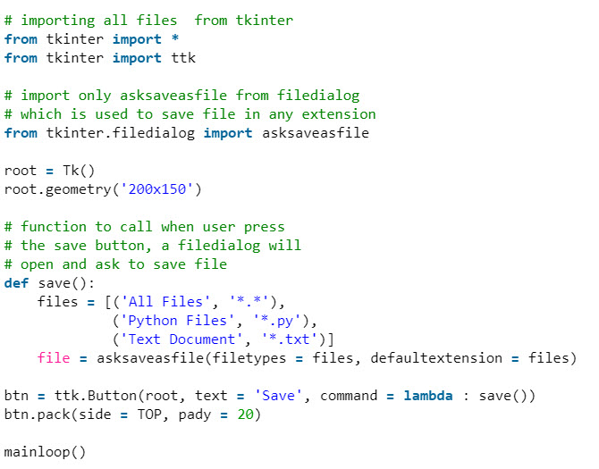
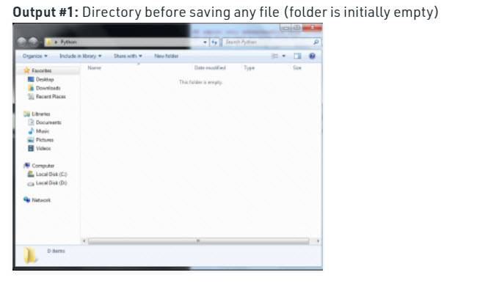
asksaveasfile() function in Tkinter

Slide 9
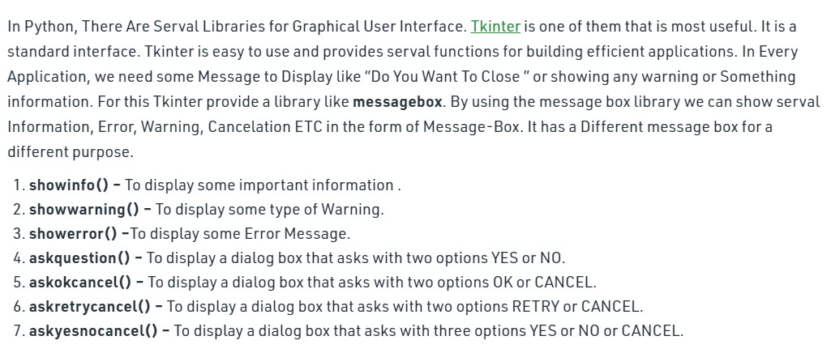
Tkinter askquestion Dialog

Slide 10
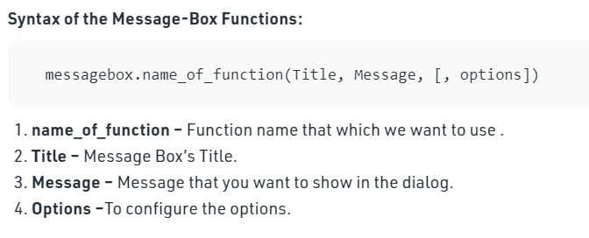
Tkinter askquestion Dialog

Slide 11
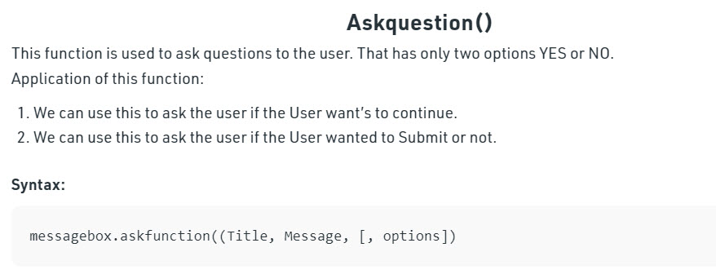
Tkinter askquestion Dialog

Slide 12
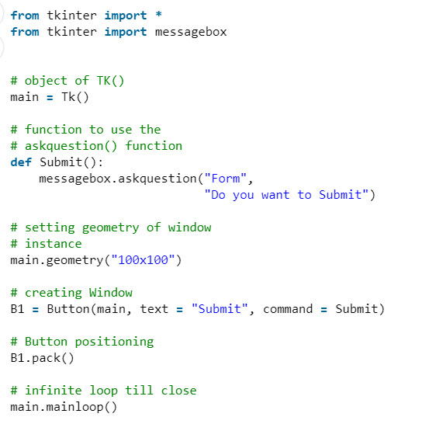
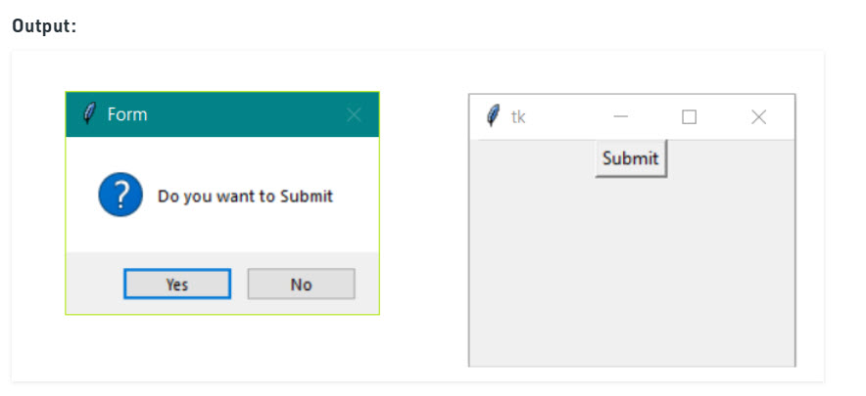
Tkinter askquestion Dialog

Slide 13
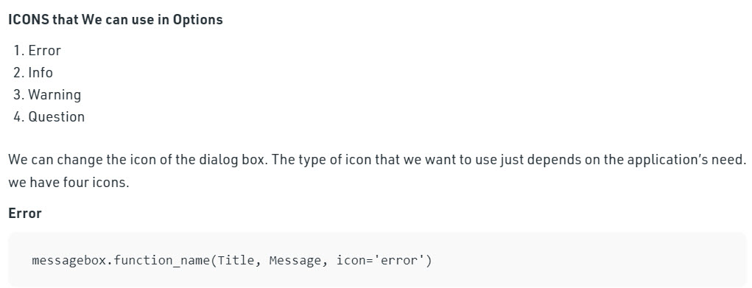
Tkinter askquestion Dialog

Slide 14
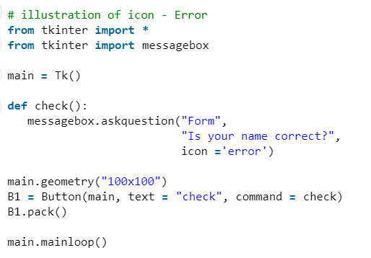
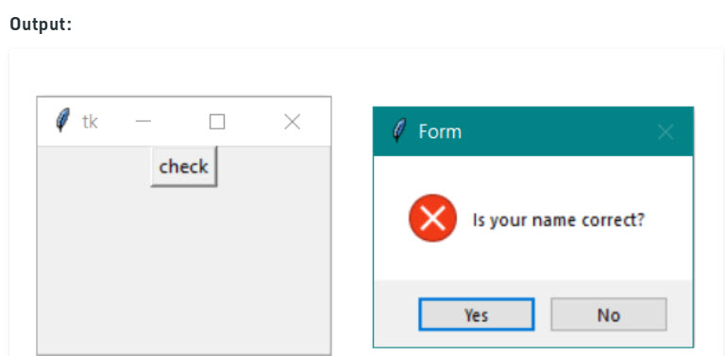
Tkinter askquestion Dialog

Slide 15
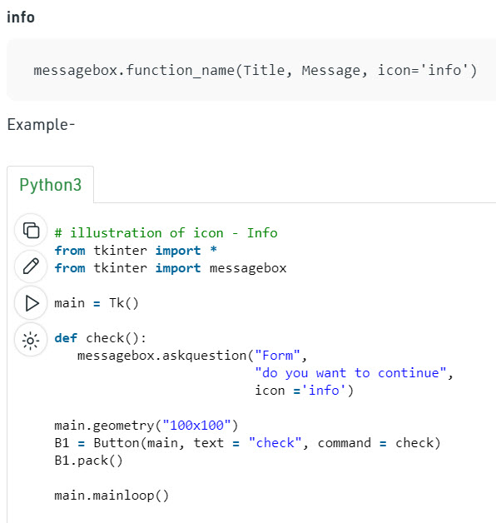
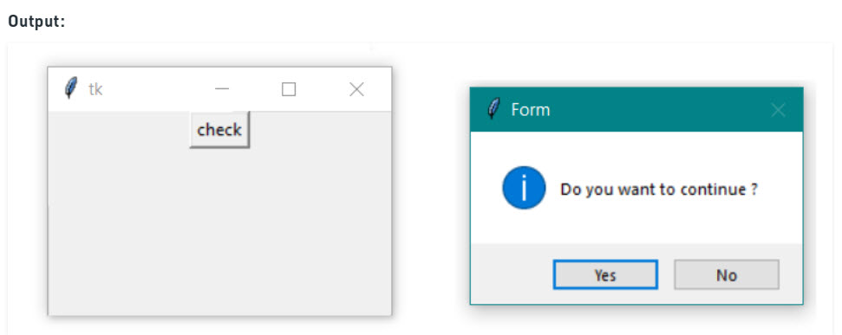
Tkinter askquestion Dialog

Slide 16
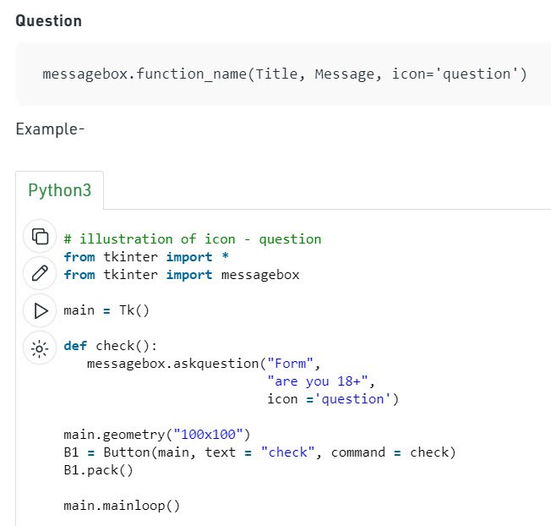
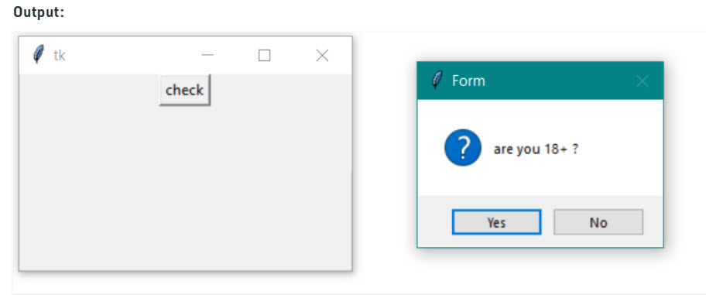
Tkinter askquestion Dialog

Slide 17
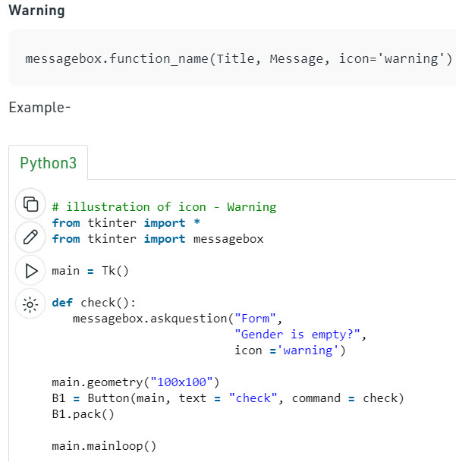
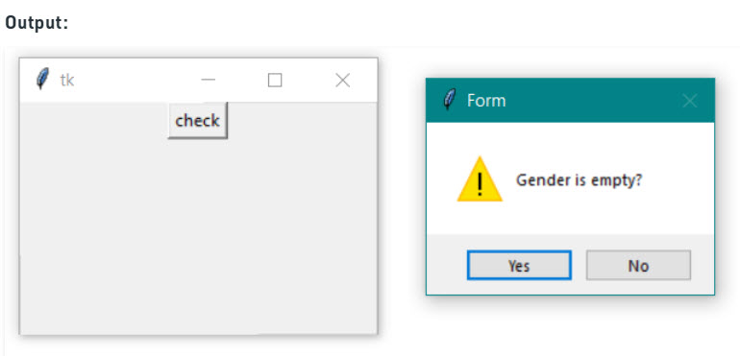
Tkinter askquestion Dialog

Slide 18
Summary
Yes/No Message Box in Python using tkinter
OpenDialog/SaveDialog in Tkinter
AskQuestionDialog

